Slide 1
selection

Slide 2
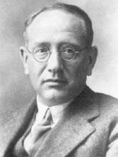
Polya’s Problem Solving Strategy
First principle: Understand the problem
Second Principle: Devise a plan
Third principle: Carry out the plan
Fourth principle: Look Back

Slide 3
Coding – previously we looked at:
Variables
Data types
Int, float and string

Slide 4
Sequence
Sequence is where a program runs statement by statement.
Once one statement has been run, the next statement is run.
Sequence is one of the oldest concepts in programming.

Slide 5
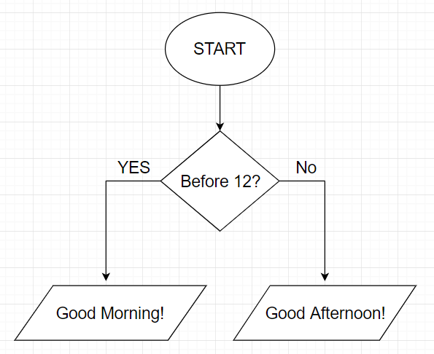
Selection
Selection is when programming structures are used to make decisions.
Selection is also known as branching.
At its basic level – a condition is checked and certain code is run when the condition is met.

Slide 6
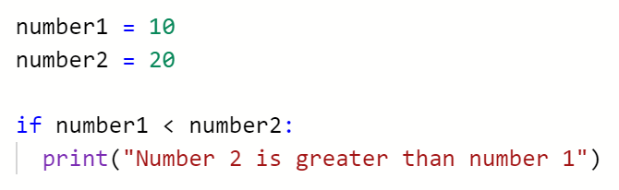
If Statement in Python
Model
if keyword
Checks to see if a condition is true
If it is, the code which is indented after the colon is run
If the condition is not true, the code is skipped
The indented code is called a block

Slide 7
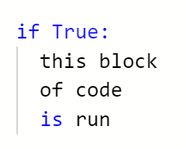
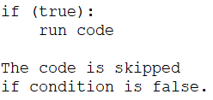
If Statement Logic

Slide 8
Relational (comparison) Operators in Python
== Equal to
> Greater than
< Less than
>= Greater than or equal to
<= Less than or equal to
!= Not equal to

Slide 9
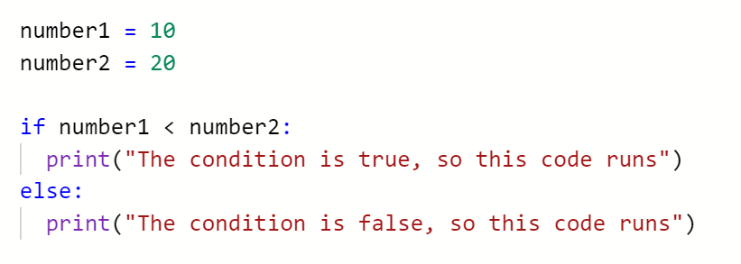
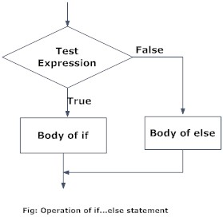
If Else
The logic for an if else statement is the same as before…
…with the addition of an else statement.
If the initial condition is false…
…the code in the else block runs.

Slide 10
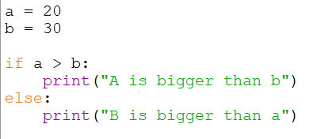

Slide 11
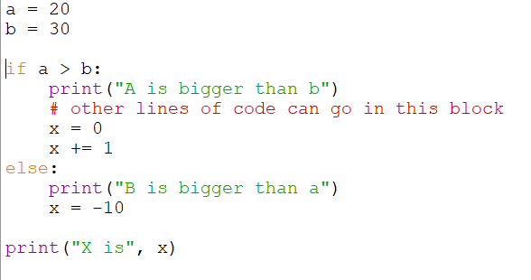
What is output?

Slide 12


Slide 13
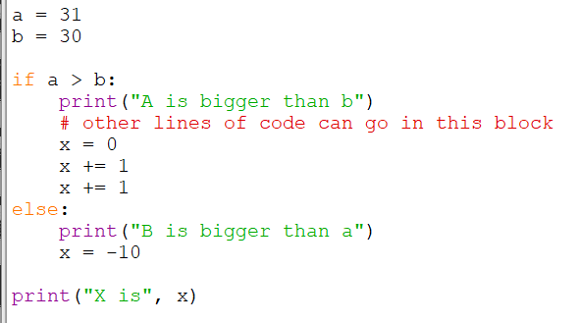
What is output?

Slide 14


Slide 15
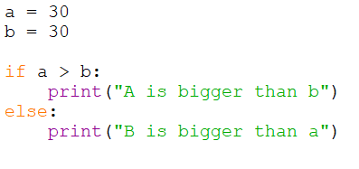

Slide 16

OH NO!

Slide 17
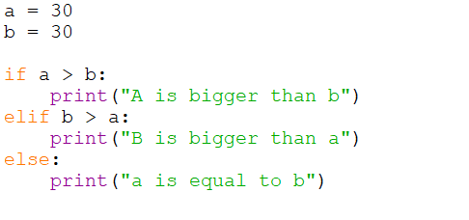
Else if (elif)
The use of an elif allows for many conditions to be checked…
…once the true condition is found, the associated code runs.
If none of the conditions are true, the else statement code is run.
You can chain together as many elif statements as needed.

Slide 18
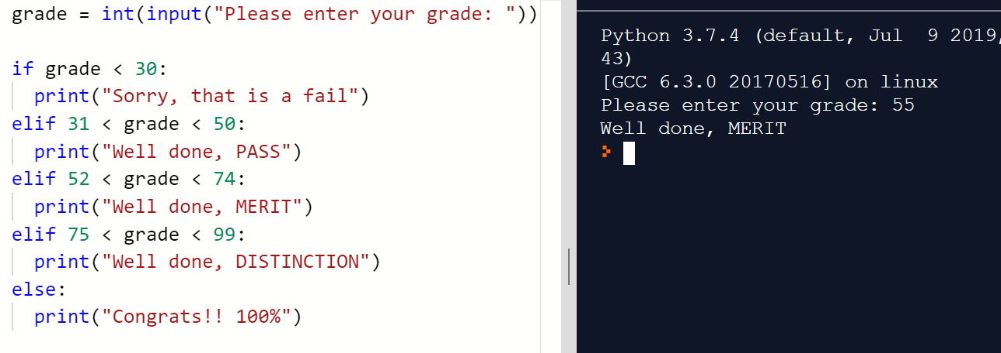

Did you spot all the bugs?
Other languages:
This is a Python idiom, the Pythonic way of doing it
Notes:
Grades: 51, -1, 100, 1000000

Slide 19
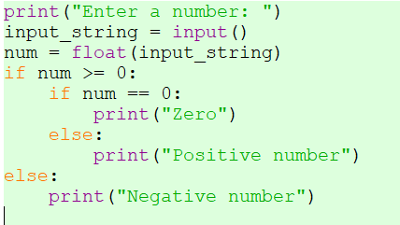
Nested

Slide 20
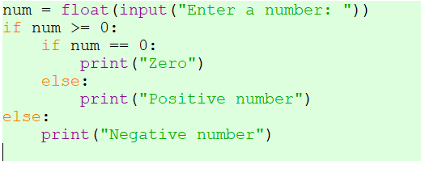
Nested – tidy the code

Slide 21
patterns

Slide 22


User Input - recap
We can use the input() function to capture input from the keyboard.
This data can be stored in a variable:

Slide 23
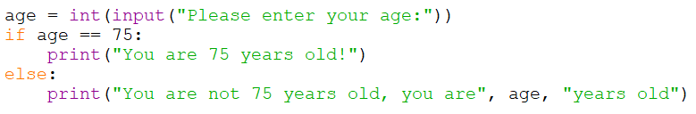
User input - recap
User input can be combined with an if statement:
What is the int() function doing?

Slide 24
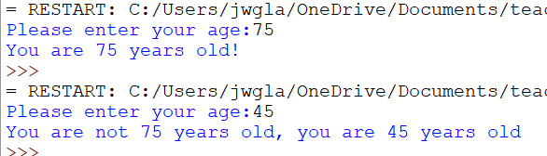

Slide 25
Activities
Next lecture is catch up on worksheets
05 - Worksheet 03 - if statement worksheet.docx
There are some activities on OneNote to practice selection in Python
Make sure that you understand what each task is asking you to do
Don’t move on to the next task until you understand the logic behind the earlier tasks.
Comment your code – leave yourself notes and reminders about what the code does.

